Slide 1



POKEMON
Predict the result of future pokemon combats
Sudeep Jayaprakash
PGDA 29

Slide 2
AGENDA
Introduction Dataset
Project Overview
System Pre-requisties
1.Overview of Dataset
2.Libraries installation
Exploratory data analysis
Correlation matrix
Model building
Conclusion
References

Slide 3
DATASET OVERVIEW
Will you be able to predict the outcome of future matches?
To do it you will have the pokemon characteristics and the results of previous combats.
Three files are available. The first one contains the Pokemon characteristics (the first column being the id of the Pokemon). The second one contains information about previous combats. The first two columns contain the ids of the combatants and the third one the id of the winner. Important: The Pokemon in the first columns attacks first.
The goal is to develop a Machine Learning model able to predict the result of future pokemon combats.
The dataset has 2 set: Pokemon and Combats.

Slide 4
LIBRARIES INSTALLATION
import numpy as np
import pandas as pd
import matplotlib as plt
import seaborn as sns
import random
import warnings
warnings.filterwarnings('ignore’)
from sklearn.svm import SVR
from sklearn.metrics import mean_absolute_error
from math import sqrt
from sklearn.tree import DecisionTreeRegressor
from sklearn.ensemble import RandomForestRegressor
import xgboost
from sklearn.decomposition import PCA
from sklearn.model_selection import train_test_split

Slide 5
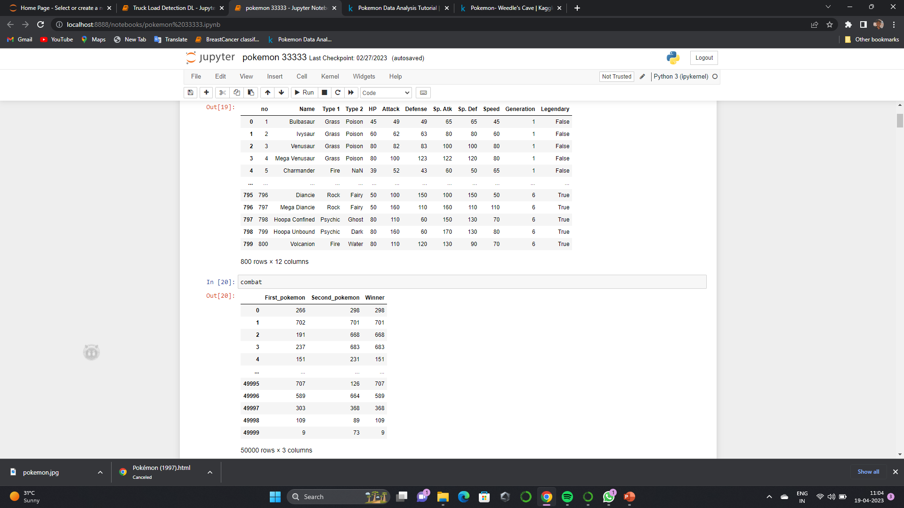
In this data we have sl.no, Name, Type 1, Type 2, HP, Attack, Defense, Sp. Atk, Sp. Def, Speed, Generation, Legendary and First_pokemon, Second_pokemon, Winner.

Slide 6
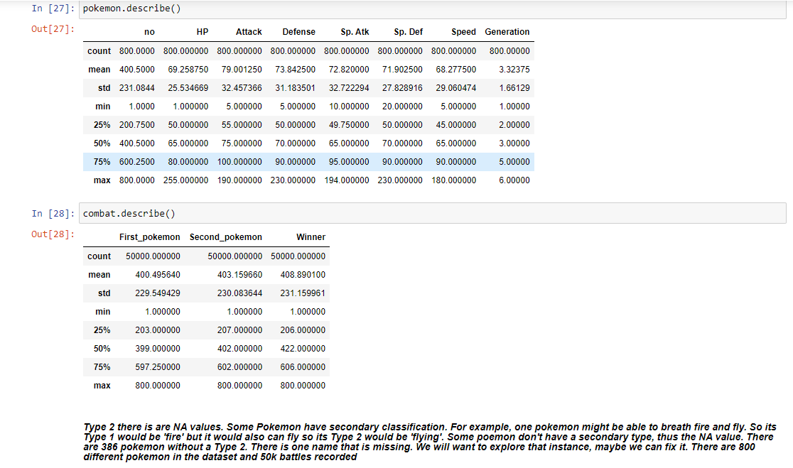

Slide 7
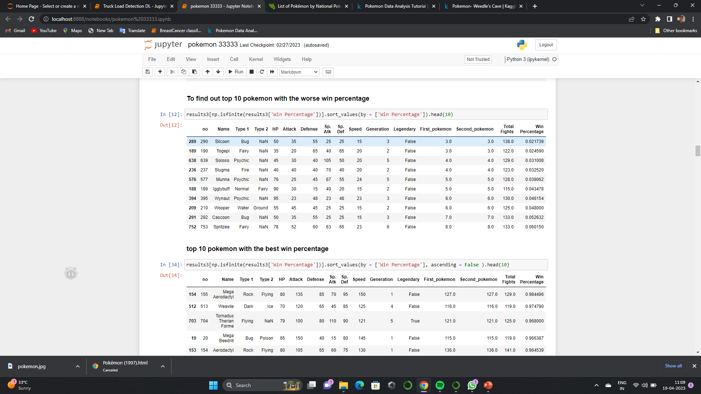
EDA
I used this website to find the missing ones
https://bulbapedia.bulbagarden.net/wiki/List_of_Pok%C3%A9mon_by_National_Pok%C3%A9dex_number

Slide 8
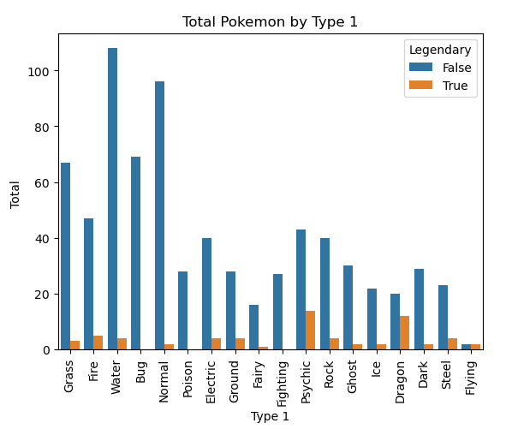
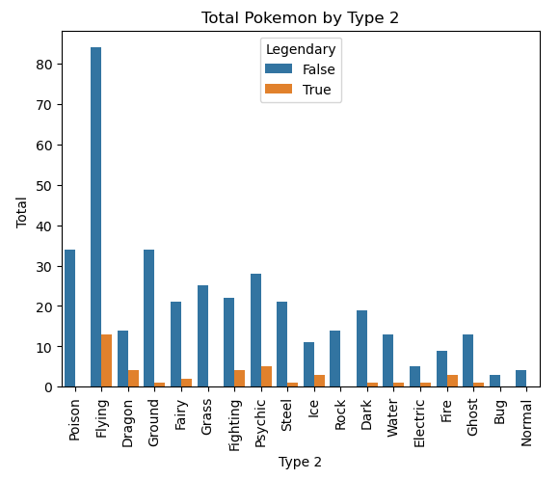
Total Pokemon by Type 1 & 2
We can see that water, normal, bug and grass are the most common type 1 and flying, ground and poison are the most common type 2.
We can see that water, normal, bug and grass are the most common type 1 and flying, ground and poison are the most common type 2

Slide 9
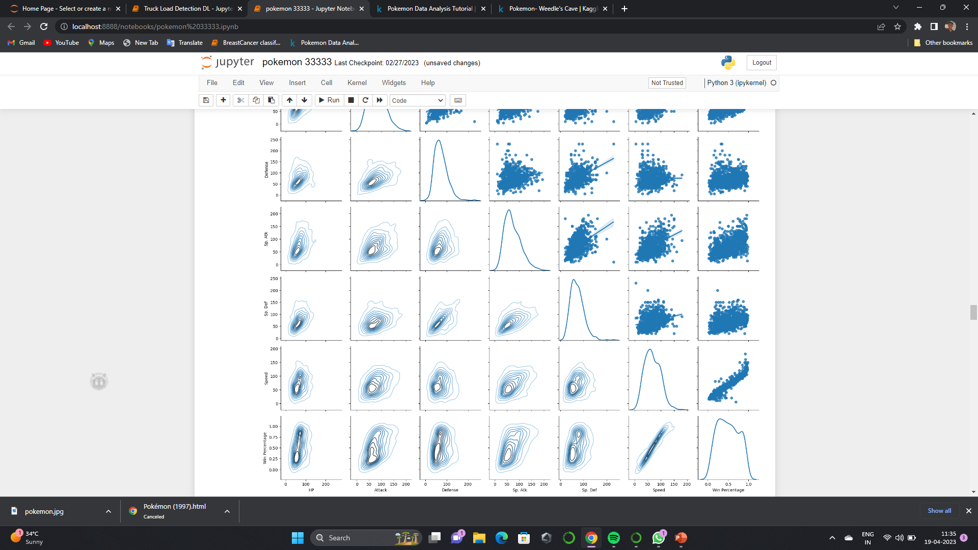
I have used PairGrid because it is better, and it provides more customizable options compared to the Pairplot. As you can tell I can have two different kinds of graphs on the upper and lower halves of the grid. In the PairGrid above we see 3 types of graphs

Slide 10
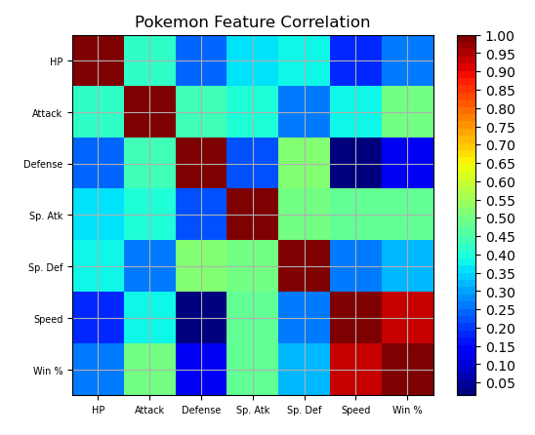
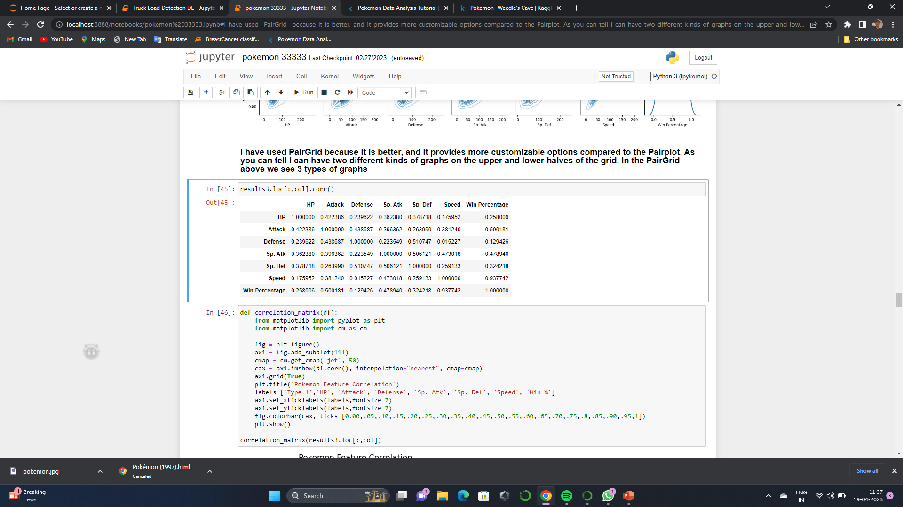
CORRELATION MATRIX
The top half above the diagonal provides the same information as the lower half. While it might be interesting to look at how the independent features are correlated, I think for our business problem we investigate the features correlated to "win %". Looking at the features with the highest correlation to winning which are speed and atatck.

Slide 11
MODEL BUILDING
Models | Regressor. Score | PCA
Multiple Linear Reg | 0.9076 | 0.9049
SVM | 0.9065 | 0.9040
Decision Tree Reg | 0.9997 | 0.9930
Random Forest | 0.9901 | 0.9859
XG Boost | 0.9973 | 0.9878
reduce the features to only speed and attack.
Models | Regressor. Score
Multiple Linear Reg | 0.9049
SVM | 0.9040
Decision Tree Reg | 0.9930
Random Forest | 0.9859
XG Boost | 0.9878

Slide 12
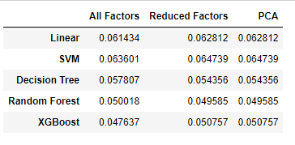
Performing model
The above table provides a comparision of the mean absolute error for each machine learning model and the different dimensionality approaches we took. The model with the least error was the Random Forest with reduced factors.

Slide 13
CONCLUSION
The above table provides a comparision of the mean absolute error for each machine learning model and the different dimensionality approaches we took. The model with the least error was the Random Forest with reduced factors.

Slide 14
References
https://datascience.stackexchange.com/questions/10459/calculation-and-visualization-of-correlation-matrix-with-pandas
https://seaborn.pydata.org/generated/seaborn.PairGrid.html
https://bulbapedia.bulbagarden.net/wiki/List_of_Pok%C3%A9mon_by_National_Pok%C3%A9dex_number

Slide 15
Thank you

